Slide 1
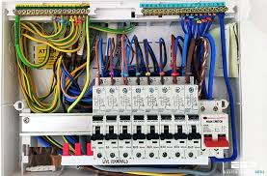
Start
Can you see the photos and guess the topic of today's lesson?
1. Electrical Circuit

Slide 2

Start
Can you see the photos and guess the topic of today's lesson?
2. Healthcare Management

Slide 3
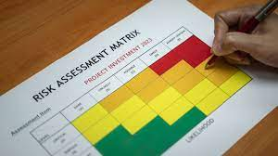
Start
Can you see the photos and guess the topic of today's lesson?
3. Risk Assessment

Slide 4
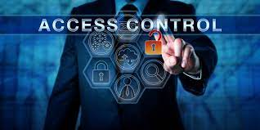
Start
Can you see the photos and guess the topic of today's lesson?
4. Access Control

Slide 5

Start
Can you see the photos and guess the topic of today's lesson?
5. Problem Solving
& Programming

Slide 6
Start
Our topic for today's lesson:
Electrical Circuit
Healthcare Management
Risk Assessment
Access Control
Problem Solving & Programming

Slide 7
Access Control

Slide 8
Learning Objectives
What is Access Control ?
Access Control Resources
Why Access Control is important?
Access Control Components
Activity 1
Access Control Model
Activity 2
Phishing Attacks

Slide 9
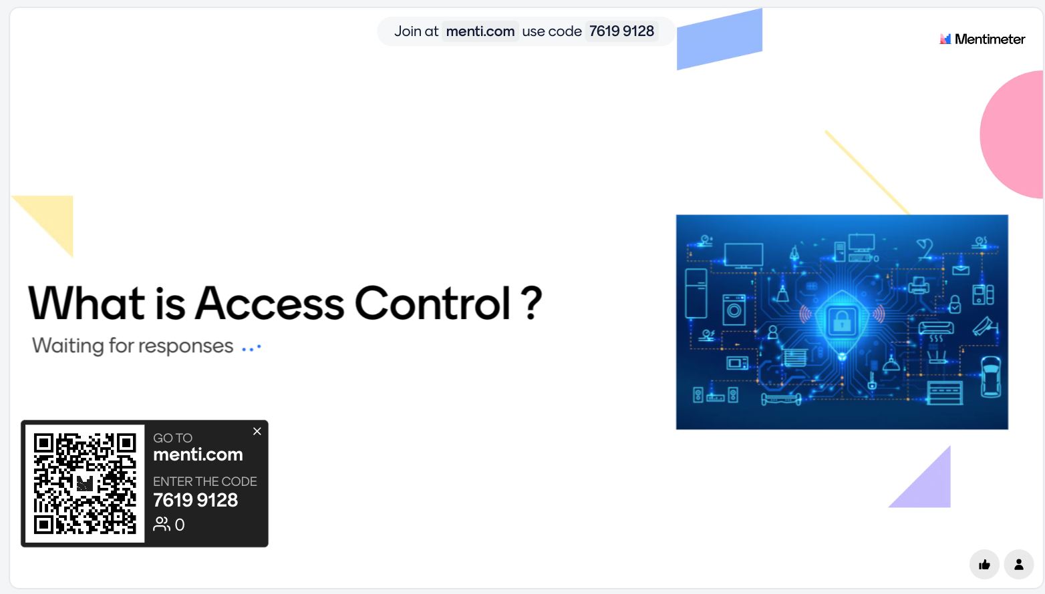
What is Access Control ?
Notes:
Encryption
Decryption
Security
Confidentiality
Algorithms
Keys
Ciphers
Privacy
Cryptanalysis
Protection
Information
Communication
Confidential
Authentication
Integrity
Cryptosystem
Key exchange

Slide 10
What is Access Control ?
Access Control refers to the policies and mechanisms used to restrict access to systems, data, and resources.
It's about ensuring only authorized people or systems can access sensitive information or perform certain actions.
Without effective access control, sensitive data can be exposed, leading to security breaches.
The primary goal of access control is to protect sensitive information and critical systems from unauthorized access and keep it always safe.

Slide 11
Why Access Control is important?
Protection of Sensitive Data: It helps protect sensitive information like (passwords and credit card numbers etc ) form unauthorised access.
Compliance and Legal Requirements: Access control helps organizations follow the rules about protecting data, avoiding potential legal and financial consequences.
Reducing the Attack: organizations reduce their attack surface, making it more difficult for hacker to find vulnerabilities.
Enhancing Accountability: It allows keeps a record of who does change in a system, so if something goes wrong, we can figure out who's responsible.
so they don't get into trouble with the law or face fines.

Slide 12
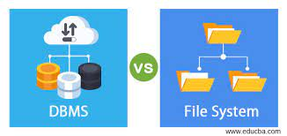
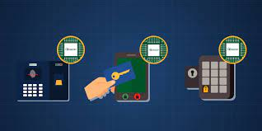
Access Control Resources
Physical Access Control: Managing physical entry to buildings, rooms, or restricted areas using methods like key cards, biometrics, or security guards.
Logical Access Control: Managing access to digital resources, such as files, databases, and applications, using authentication, authorization, and encryption.

Slide 13
Principles of Access Control
1. Least Privilege: Users get the minimum access they need.
2. Separation of Duties: Tasks are divided to prevent fraud/errors.
3. Need-to-Know: Access is given only for necessary tasks.
4. Defense in Depth: Use multiple layers of security.

Slide 14

Access Control Policy Lifecycle
1. Initiation: Define policy objectives.
2. Development: Create detailed policies.
3. Implementation: Apply the policy.
4. Maintenance: Regularly manage and update.

Slide 15
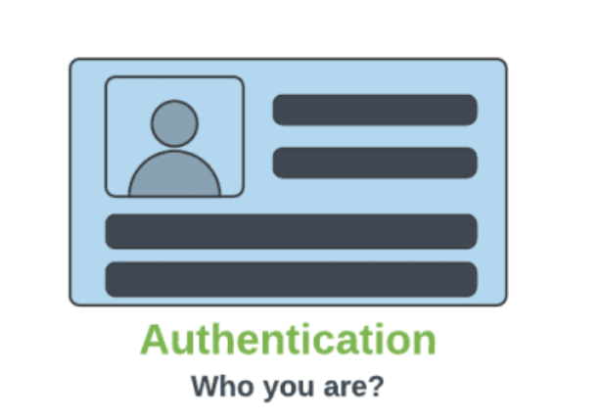
Access Control Components
Authentication: Authentication is the process of verifying the identity of users or systems trying to access a resource.

Slide 16
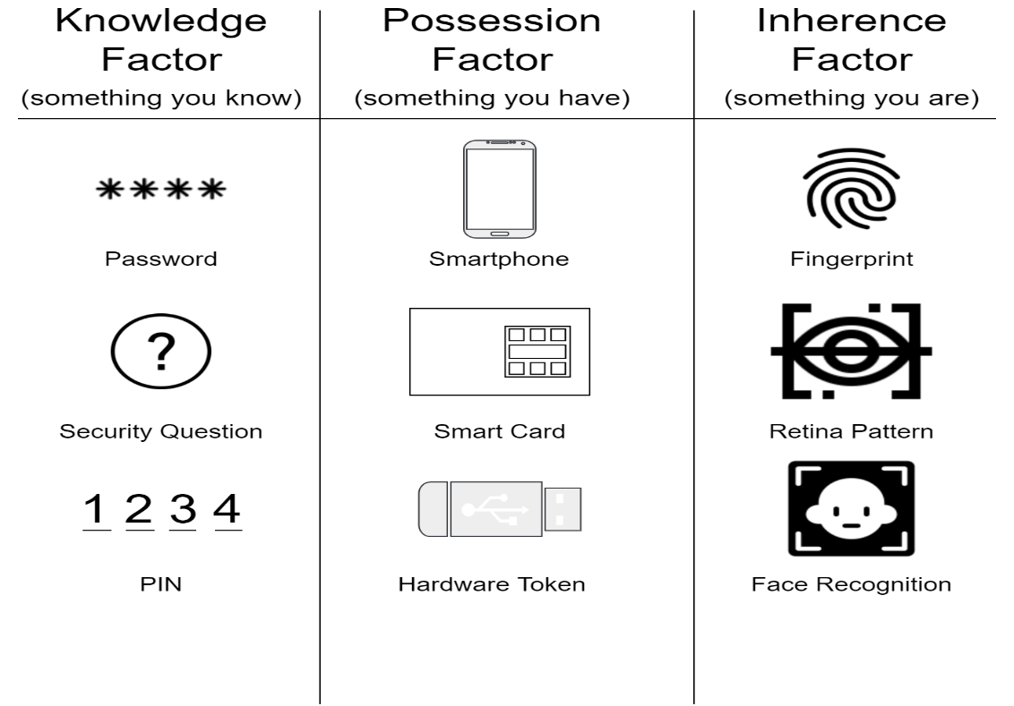
Access Control Components
The three authentication factors are:
Knowledge Factor
Possession Factor
Inherence Factor

Slide 17
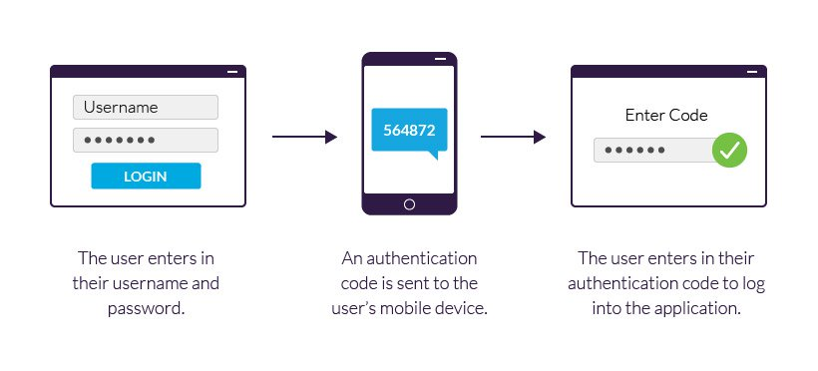
Access Control Components
Two-Factor Authentication (2FA): is a security process where you use two different methods to prove your identity when logging into an account.

Slide 18
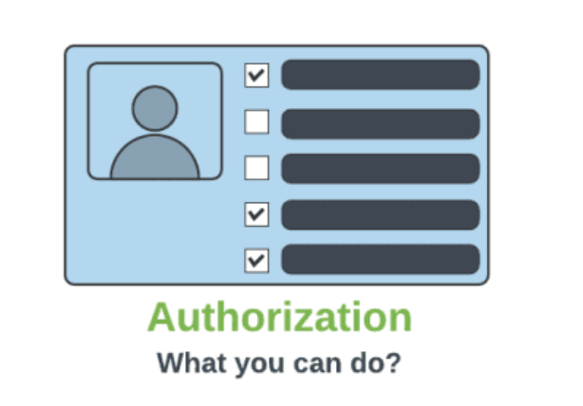
Access Control Components
Authorization: The authorization process determines what a user or system is allowed to access after authenticating.

Slide 19
Access Control Components
Authorization: It is based on the user's role, permissions, privileges.
User Roles: The company has three user roles - regular employees, managers, and administrators.
Permissions: Different roles have different permissions. Regular employees can access shared documents, managers can access those documents plus employee performance data, and administrators have access to everything, including server settings.
Privileges: Regular employees have read-only privileges, managers can read and edit documents, and administrators have full control over the system.

Slide 20
Access Control Components
Access Control Lists (ACLs): are like lists of rules that decide who is allowed to access or use something, like a computer file or a network resource.

Slide 21
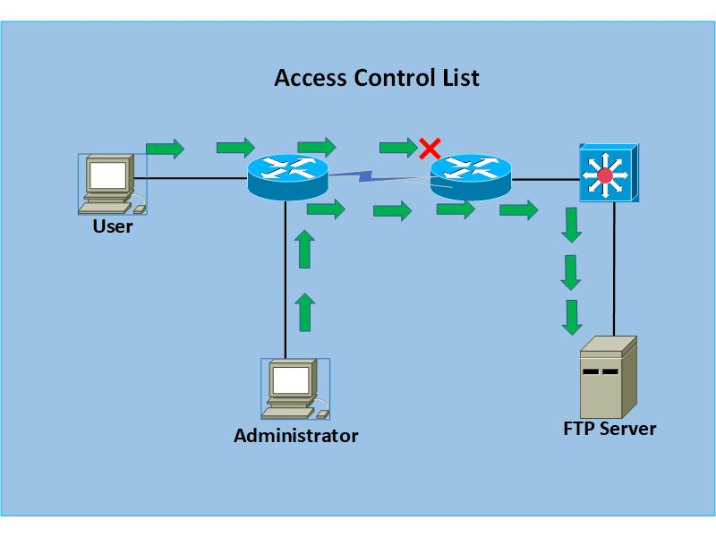
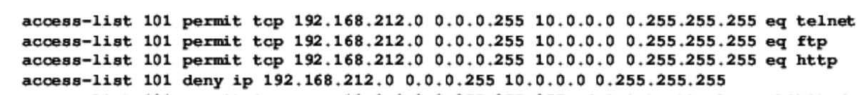
Access Control Components
Network Devices: Routers, switches, and firewalls can use ACLs to control network traffic. ACLs can be configured to allow or deny specific IP addresses, protocols, or ports.
Notes:
The goal of encryption is to ensure that even if the interceptor captures the ciphertext, they should not be able to decrypt it back into plaintext without the key.

Slide 22
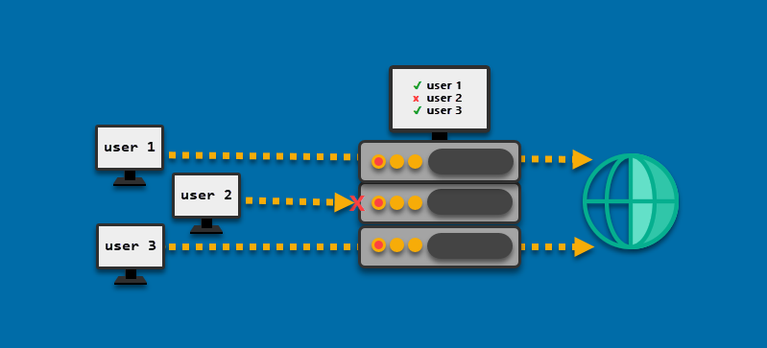
Access Control Components
Web Servers: Web servers can use ACLs to restrict access to certain web pages or directories. This helps protect sensitive data and control which users or groups can access specific parts of a website.

Slide 23
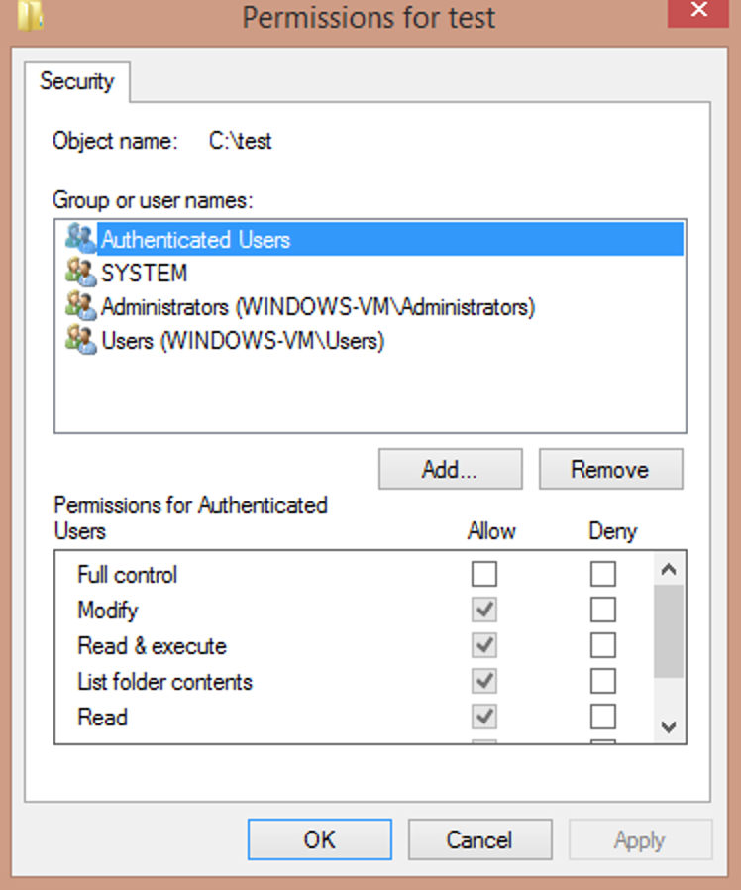
Access Control Components
File Systems: ACLs are often used in file systems to control access to files and directories. They specify which users or groups have permissions to read, write, execute, or modify specific files or folders.

Slide 24
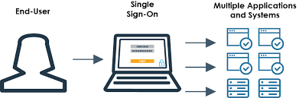
Access Control Components
Single Sign-On (SSO): Log in once to access multiple systems.

Slide 25
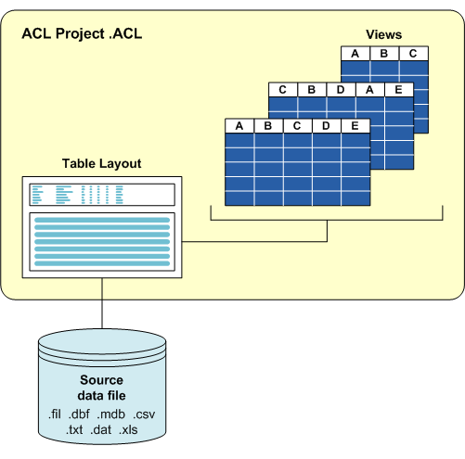
Access Control Components
Databases: In database management systems, ACLs are used to specify which users or roles can perform operations like querying, inserting, updating, or deleting data in the database.

Slide 26
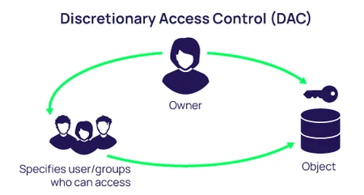
Access Control Model
Discretionary Access Control (DAC): In DAC, the owner of a resource decides who gets access and what they can do with it. It's like a file on your computer that you can set as private or share with specific people.

Slide 27
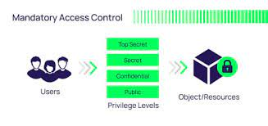
Access Control Model
Mandatory Access Control (MAC): is a strict security system that decides who can access what based on privilege security levels, making sure only authorized users can access specific information

Slide 28
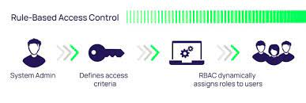
Access Control Model
Role-Based Access Control (RBAC): RBAC assigns roles to users, and each role has certain permissions. For example, in a company, there might be roles like "manager" or "employee,"

Slide 29
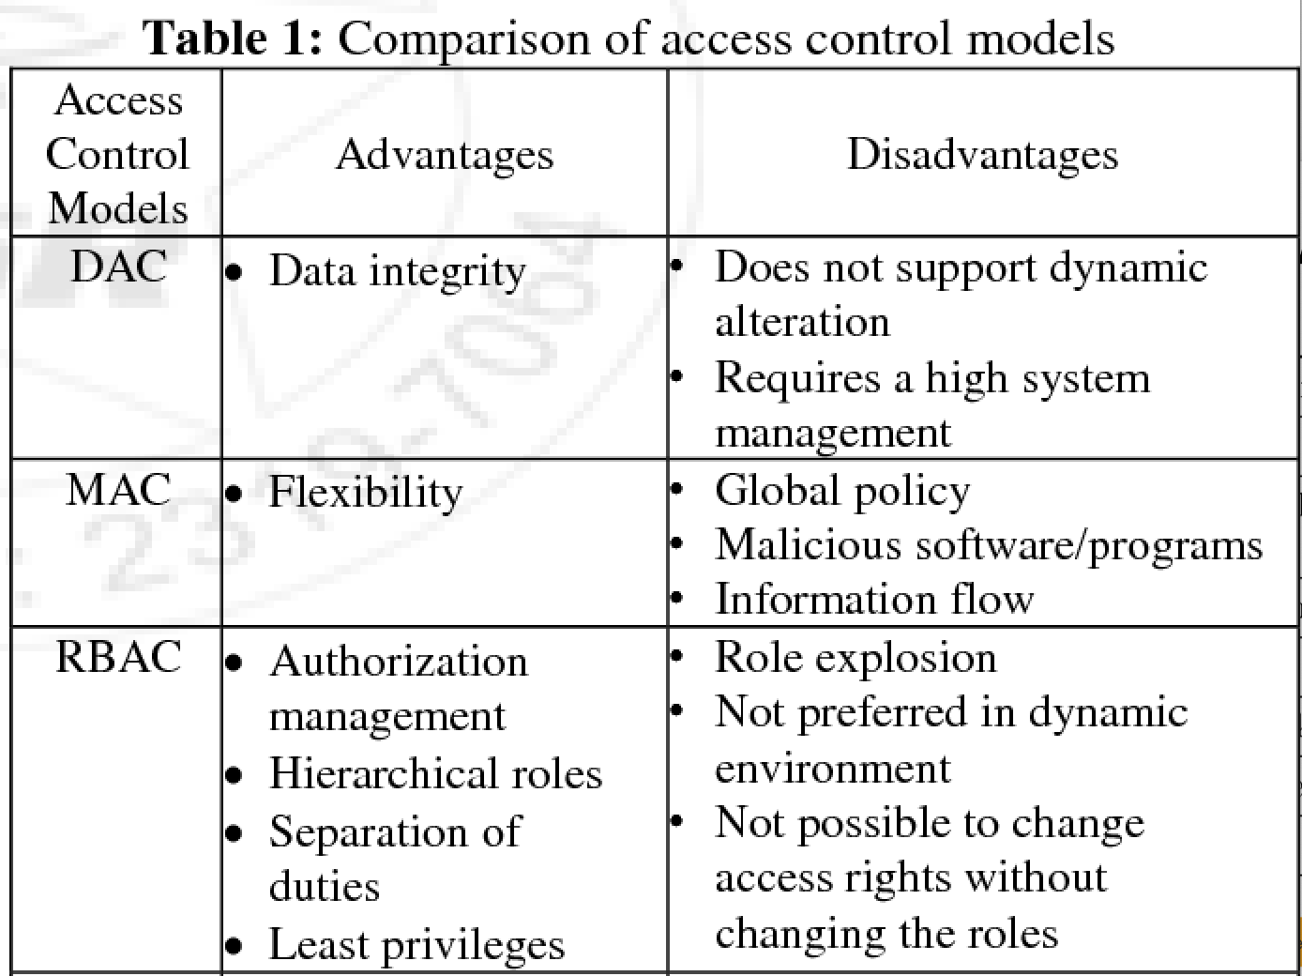
Comparison of Access Control Models

Slide 30
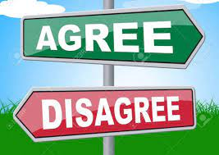
Activity
Agree or disagree with information security statements.

Slide 31
information security statements.
“Using the same password for multiple accounts is acceptable as long as it is complex.” ✅ Agree / ❌ Disagree
“It’s safe to click on links in emails if they come from someone you know.” ✅ Agree / ❌ Disagree
“Installing antivirus software means you don’t need to worry about other security measures.” ✅ Agree / ❌ Disagree
“It’s okay to write your password on a sticky note if you hide it well.” ✅ Agree / ❌ Disagree
“Two-factor authentication (2FA) makes your account more secure.” ✅ Agree / ❌ Disagree
“Public Wi-Fi is always safe to use for online banking if the website is HTTPS.” ✅ Agree / ❌ Disagree
“You should report a suspected phishing email to your IT department.” ✅ Agree / ❌ Disagree
“All files downloaded from the internet are automatically safe if scanned by antivirus software.” ✅ Agree / ❌ Disagree

Slide 32

Phishing Attacks
Phishing attacks are social engineering attacks that trick users into an attempt to steal sensitive information such as login credentials, credit card numbers, or personal data.
These attacks often come in the form of emails or text messages or voice call.
Prevention can be by avoiding clicking links, never giving sensitive information via phone not replay an unsecured text messages.

Slide 33
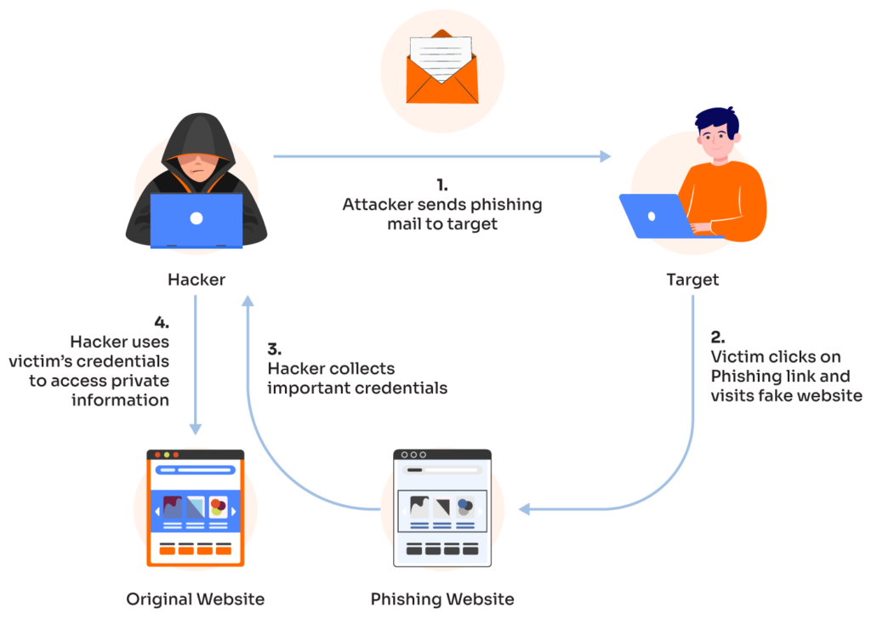
How Phishing Attacks Work

Slide 34
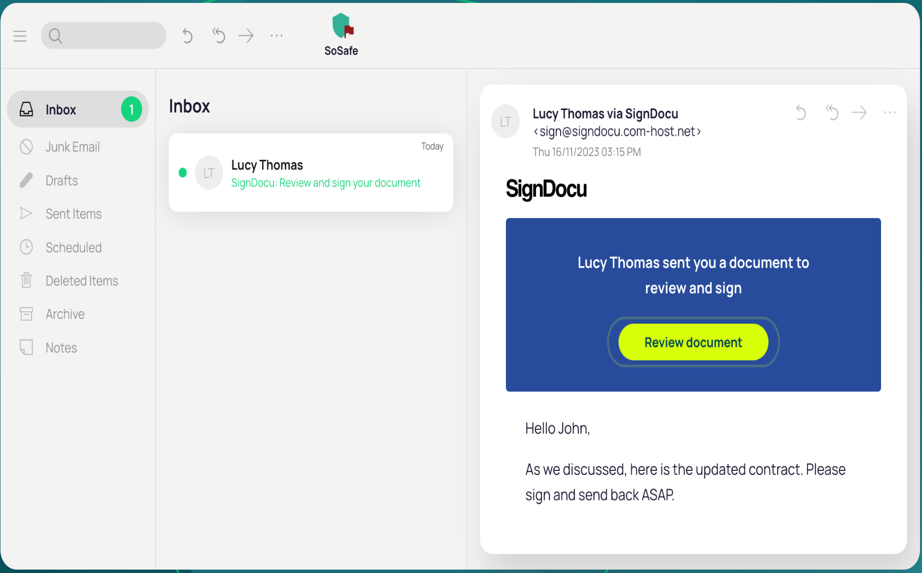
Phishing Using Email

Slide 35
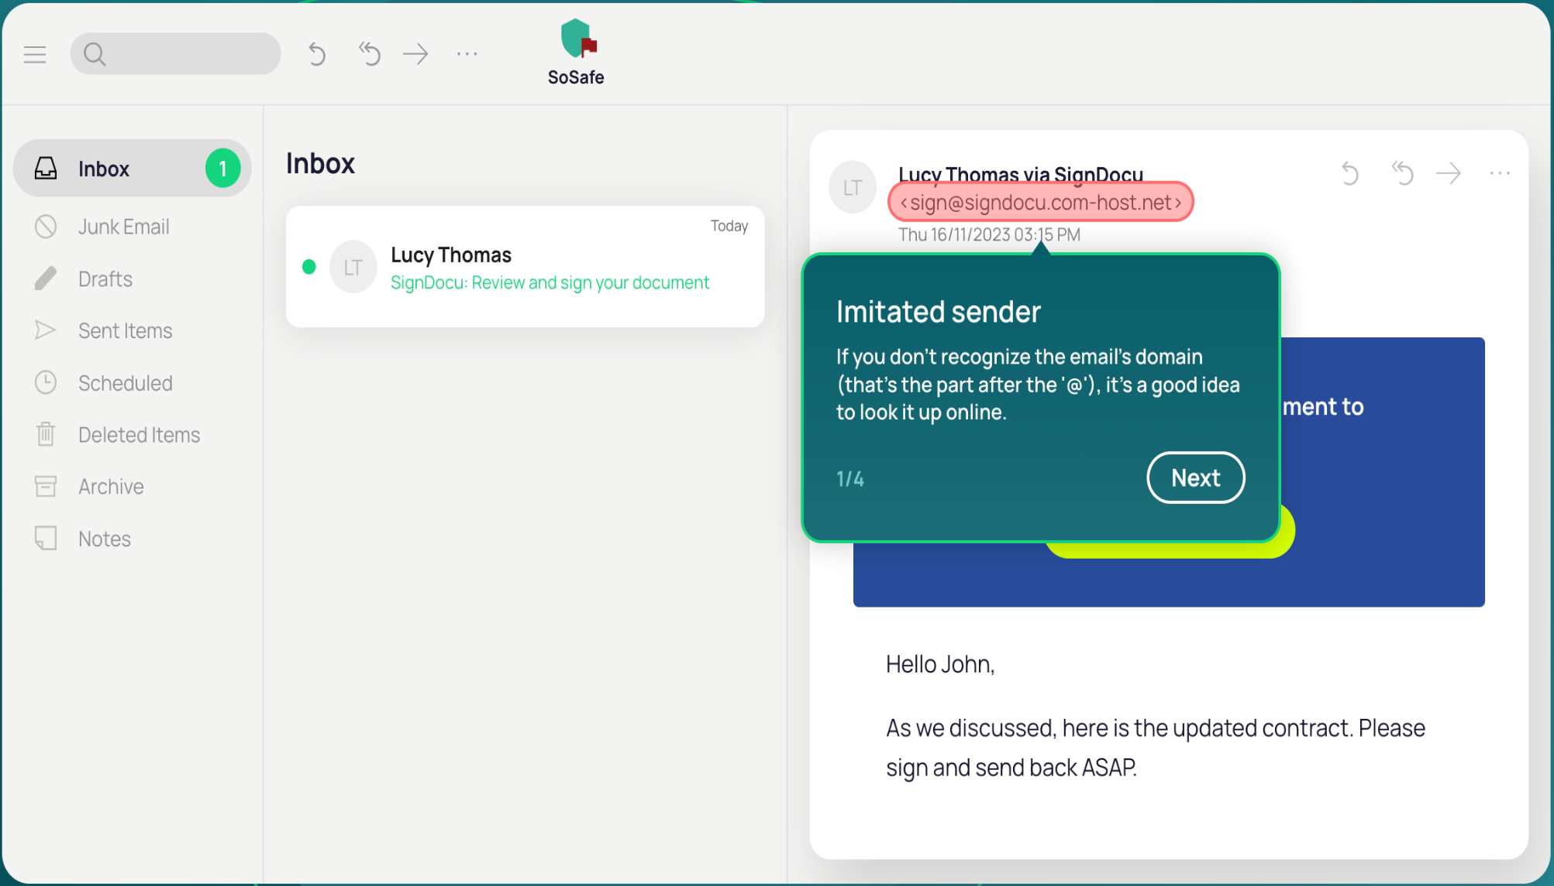
Tips to know if this email is spam

Slide 36
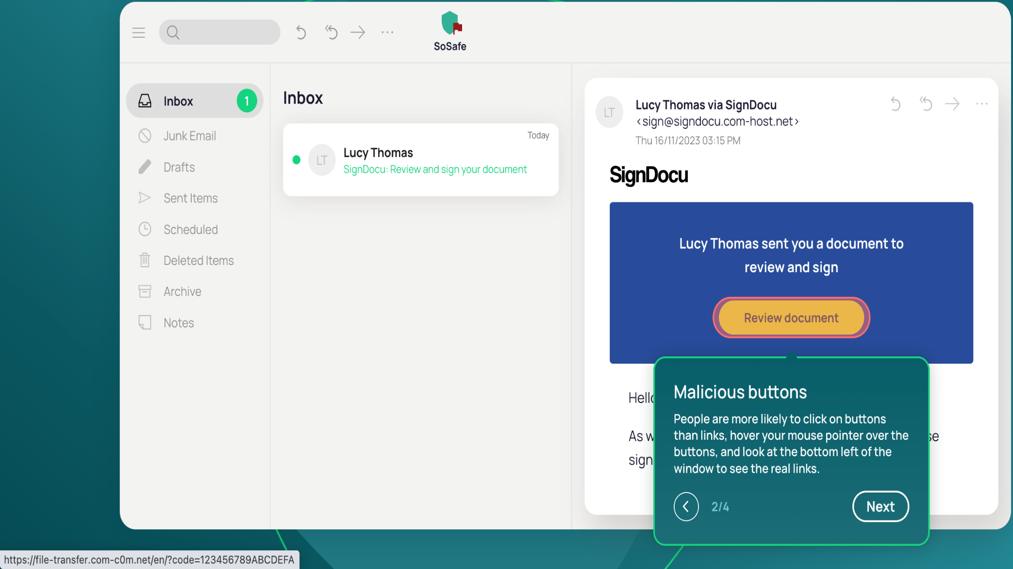
Tips to know if this email is spam

Slide 37
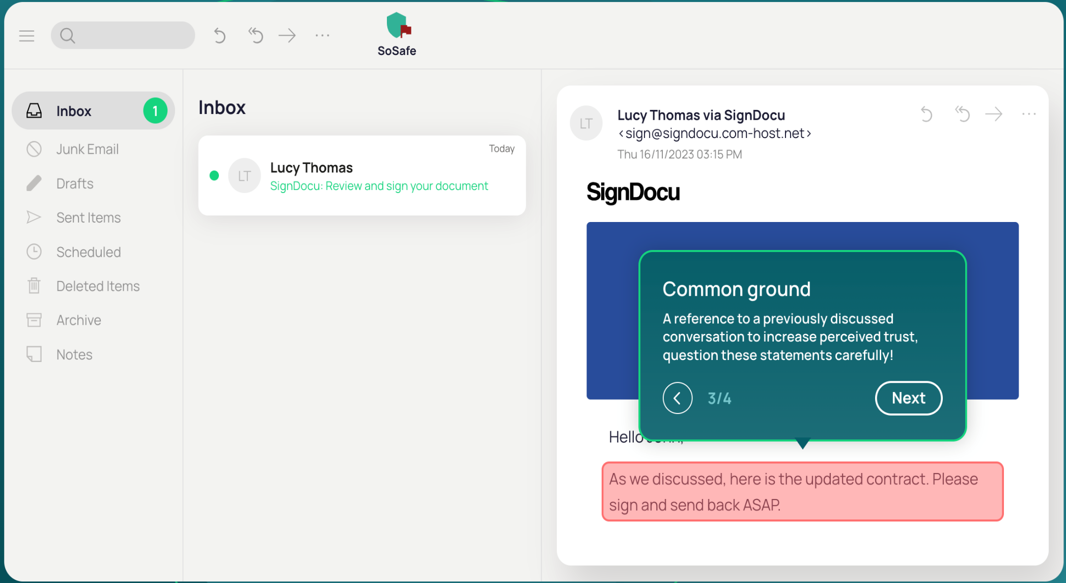
Tips to know if this email is spam

Slide 38
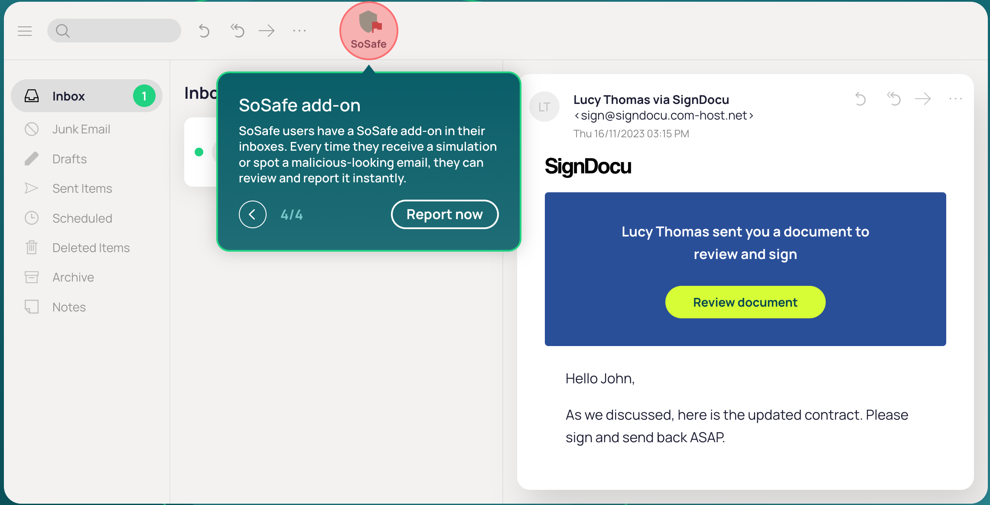
Tips to know if this email is spam

Slide 39
Discussion
Share examples of industries or sectors where access control is of most importance (e.g. healthcare, finance). What specific requirements and regulations apply in these sectors?
Take 10
Discuss with your team

Slide 40
What’s next on the agenda?
Break: 20 minutes
Lab Explanation
Lab Work

Slide 41


